Slide 1
Children with Trauma & Attachment Disturbances:
A Beginner’s Guide In Healing the Most Challenging Children

Slide 2
Shirley Crenshaw, MSW, LCSW:
Expert in Making Mistakes
Child Welfare Worker: 28 years
MSW, Washington University in St. Louis, 1995
Psychotherapy, 21 years

Slide 3
Learning objectives
To recognize the signs, symptoms, and origins of attachment disturbances
To learn the effects of trauma on object permanency and object constancy
To list the effects of trauma (neurological, physiological, and psychological) on basic trust and safety
To learn how to utilize parents (and teachers) in healing the traumatized/attachment-resistant child
To define specific therapeutic programs to address behaviors (EMDR, Narrative Tx, Theraplay, Brain Gym, HeartMath, S.I., Mirroring, MeMoves, Roleplay, Tools of the Mind, etc.)

Slide 4
What is Attachment?
The ability to trust and form reciprocal, healthy, and authentic relationships.
It gives us the ability to regulate our emotions, have a conscience, and experience empathy
It is the corridor to all development, including motor skills, endorphin production, neurological, physiological, and psychological development
Develops in 1st 3 years
Template of all future relationships. Gives us the ability to seek safety in relationships.

Slide 5
Trauma
Stress that can be:
Overwhelming
Unpredictable
    Prolonged
Creates:
Helplessness/Hopelessness/Powerlessness
Fear/Terror: “It felt like being buried alive”

Slide 6
Trauma
Interferes with normal development
Interferes with memory processing
Memories often not accessible to conscious
Memories easily triggered by sensory clues/emotions (easily dysregulated)
Flashbacks/dissociation/hypervigilance/nightmares
Continual state of alarm/anxiety (effects on immune system)
Inability to manage/regulate emotions/lacks coping ability (leads to addictions- relational substitutes - Gabor Mate – heroin=warm hug)

Slide 7
Trauma & Implicit Memory (J. Briere)
Anger has to do with abandonment, though because it is in the implicit memory, they do not know what they are angry about.
PTSD – Flashbacks on an implicit level – acting out behavior often stems from implicit trauma
See people as who one expects them to be – not who they are (source attribution error)
You are as bad as what happened to you – inadequate, unworthy of care, unlovable

Slide 8
How do attachment problems start?
Early trauma, abuse, or neglect (Implicit vs. explicit memory)
Acts of Omission (neglect) has a much more negative effect on children than acts of commission (J. Briere)
Early hospitalizations and/or medical procedures/unrelieved pain (colicky, ear, etc)
Fetal Alcohol Spectrum Disorders
Notes:
)

Slide 9
Domestic violence/stressors during pregnancy
Multiple placements/caregivers/institutionalization
Post-partum depression
Environmental Stressors (includes poverty)
Parents with their own unresolved trauma/attachment issues (role reversal)
Parent’s drug/alcohol addictions
Crying it out (young infants)

Slide 10
Relationship Trauma:
Gut wrenching sadness when separated from caretaker (J. Briere)
Research shows psychologically unavailable caretakers that cannot maintain positive connection with their children have much worse outcomes. We are wired to be dependent. (J. Briere)
Relationship schema: Being close to people hurts – they will betray you and hurt you.

Slide 11
Effects of early relationship trauma
Lack of Trust -leads to pseudo-independence/emotional isolation. Unable to use caregiver as source of comfort/gratification. Seeks external sources of regulation (addictions)
Shame – Developmentally egocentric
Arrested emotional development /conscience development
Object permanency/constancy
Neurology and Physiology (Stinky Foot Syndrome- S. Crenshaw)
Defenses and trauma triggers/transitional trauma
Easily dysregulated/hyperaroused (looks like ADHD)

Slide 12
Gabor Mate, M.D.:
The fewer endorphin-enhancing experiences in first years of life, the greater need from external sources.
What sets addicts apart is the extreme degree of stress they had to endure early in life.
Stressed, anxious, or depressed parents have great difficulty initiating enough of those emotionally rewarding, endorphin-liberating interactions with their children.

Slide 13
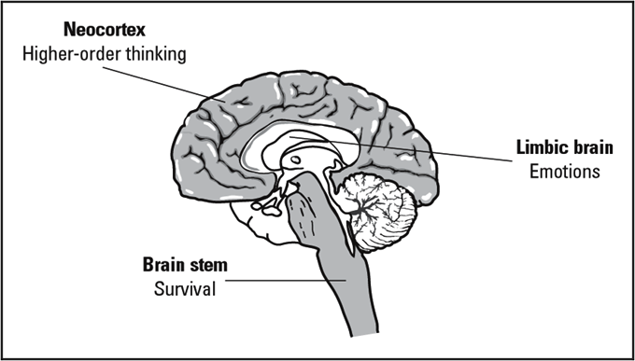

Slide 14
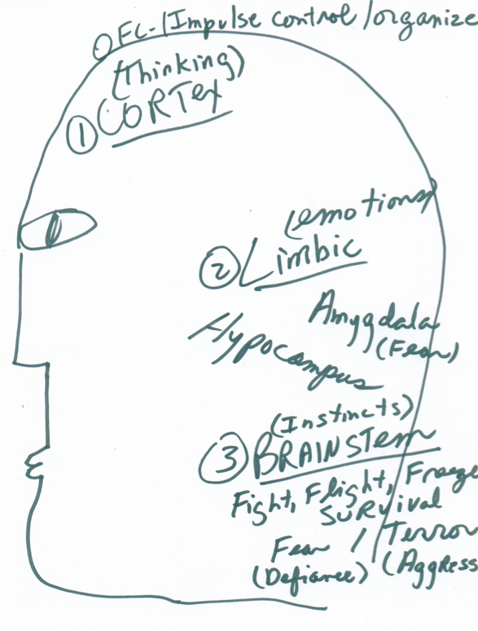

Slide 15
Common Triggers
Parent/teacher saying “no”
Vacations
Birthdays (for foster and adopted children)
Transitions
Sick Parents
Bedtime
May (end of school and Mother’s day)
Parents have same name as 1st Mom & Dad

Slide 16
Common Negative Cognitions
I am not safe
I am bad
I cannot get what I need
I have to provide for myself (child neglect)
I must be in control to feel safe (manipulation: the belief that you will never meet my needs)
It’s not safe to be close (abandonment)
It’s not safe to depend on parents
Everyone I love leaves me (esp. parents)
Notes:
MY PARENTS’ EXPERIENCE OF ME GOES INTO ME (Dan Hughes).

Slide 17
Traumatized children often…..
Try to control others
Show too much or too little affection
Refuse to cooperate
Can be overly friendly/charming with strangers
Lack empathy for others and self
Lack cause/effect
thinking
Chatter non-stop(Bessel v.d. Kolk)
Can’t keep friends
Lack eye contact

Slide 18
Isolate themselves emotionally
Demonstrate pseudo-independence (lack trust)
Lie (fear of rejection/abandonment if make mistakes)
Steal
Hoard food
Fear failure (have to be perfect – or perfectly bad)
Fear of trusting happiness– lacks positive (as well as negative) affect tolerance

Slide 19
Hurt others/self
Seek attention inappropriately (feel invisible)
Lack intersubjectivity (ability to reflect on other’s experiences) (D. Hughes)
Have black/white thinking
Never believe they will have enough
Assume parents’ motives are negative
Have tension reduction behaviors (trichotillomania, cutting, rocking, thumb-sucking, excessive masturbation, etc.)

Slide 20
Traumatized children try to make parents:
Angry – working through abuse (see if you will respond with anger and abuse)
Afraid of them – don’t trust parents to be in charge – strive to be the “alpha dog” of family
Give up on them – get this abandonment over with
Feel inadequate/worthless/shamed – because they feel inadequate/worthless/shamed
(Daniel Hughes)

Slide 21
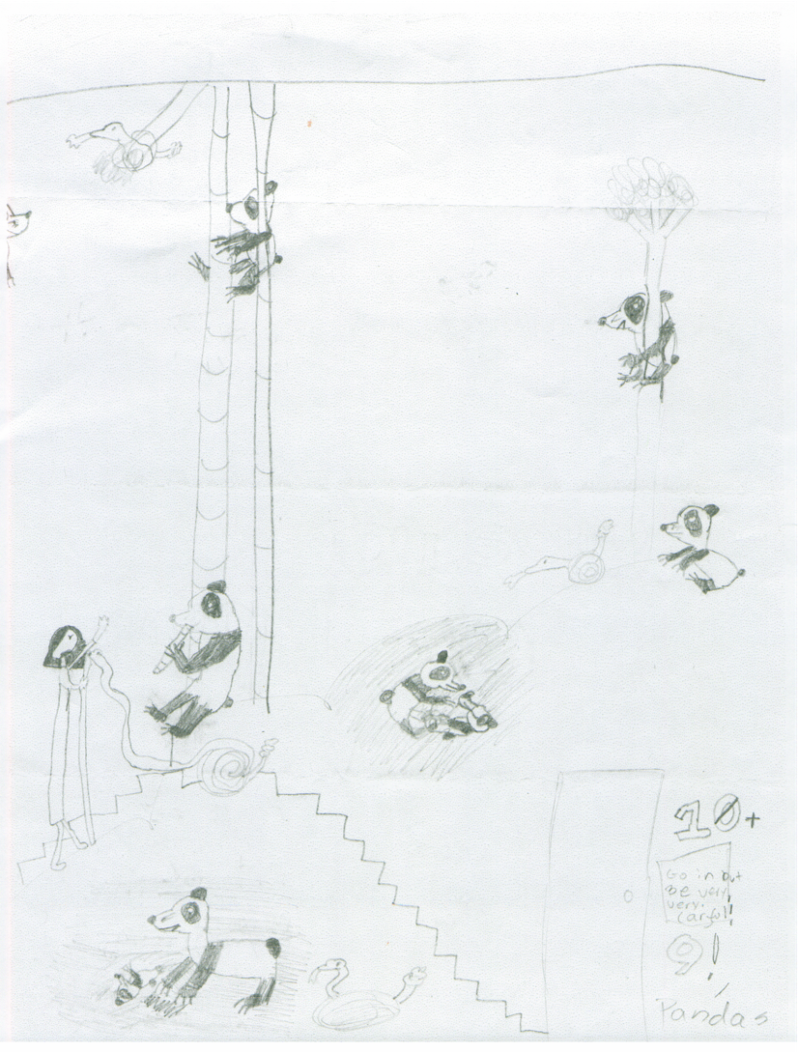
Pandas & Snakes
(Love Hurts)

Slide 22
Sense of Time | Extended Future | Days Hours | Hours Minutes | Minutes Seconds | No Sense of Time
Arousal Continuum | REST | VIGILANCE | RESISTANCE Crying | DEFIANCE Tantrums | AGGRESSION
Dissociative Continuum | REST | AVOIDANCE | COMPLIANCE | DISSOCIATION | FAINTING
Regulating Brain Region | NEOCORTEX Cortex | CORTEX Limbic | LIMBIC Midbrain | MIDBRAIN Brainstem | BRAINSTEM Autonomic
Cognitive Style | ABSTRACT | CONCRETE | EMOTIONAL | REACTIVE | REFLEXIVE
Internal State | CALM | AROUSAL | ALARM | FEAR | TERROR

Slide 23
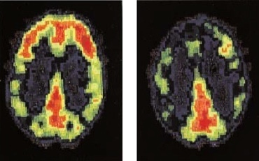

Slide 24
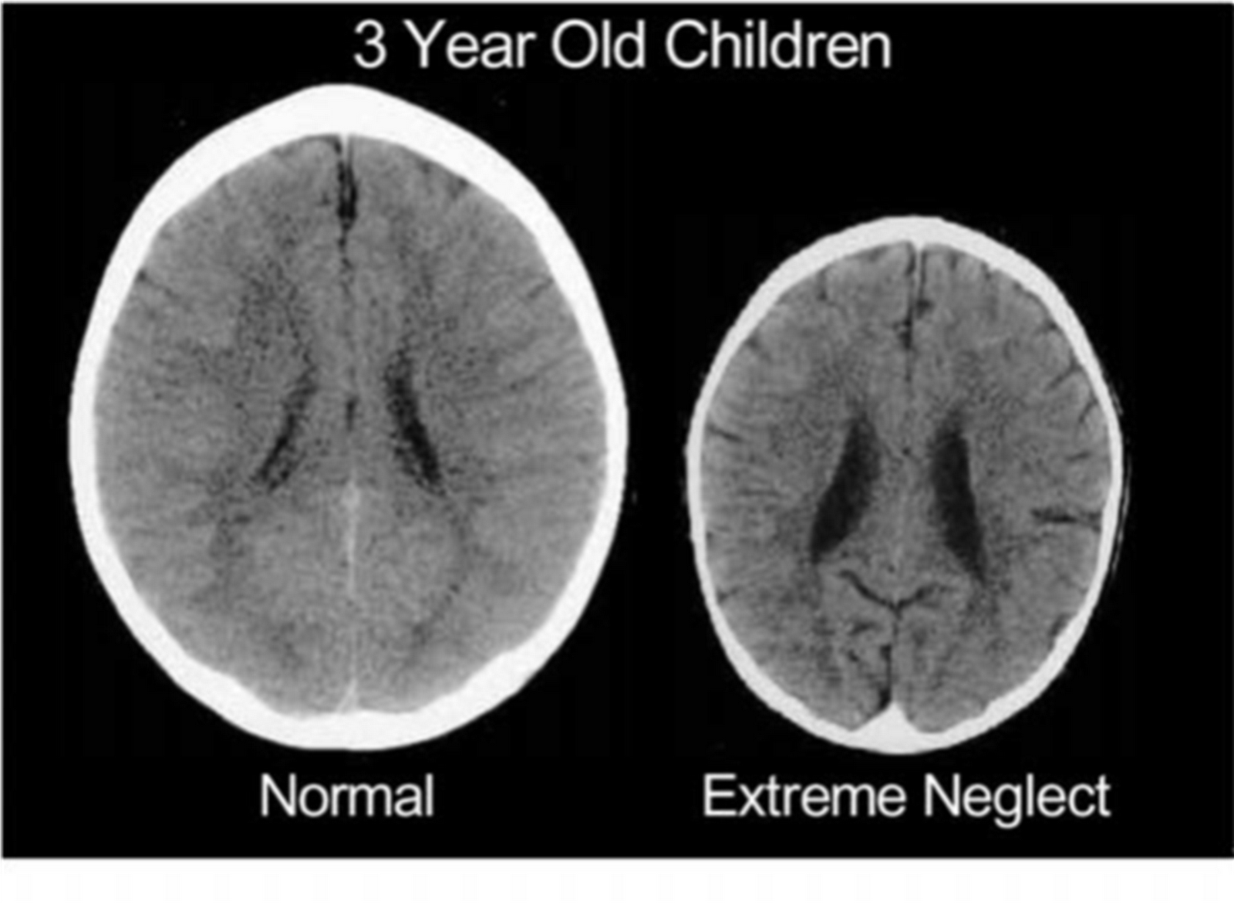

Slide 25
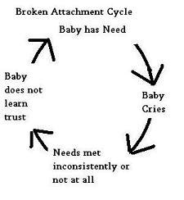

Slide 26
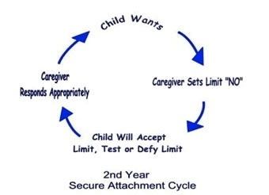

Slide 27
Defenses
(I must protect myself)
Defiance
Lying
Stealing
Sibling Rivalry
Dissociating
OCD
Denial of Affect
Substitute affect/machismo
Controlling
Pseudo-independence
Anger (hides fear/shame)
Aggression
Running away
Push away behavior
Triangulation
Vulnerability = Danger
Notes:
.

Slide 28
Traumatized Children Traumatize their Parents (especially Moms)
Feeling of being a failure as a parent
Feeling of being alone
Feeling of being frustrated/invalidated/worthless
Exhaustion – both mentally and physically
Parent feels abused and sees child as “perpetrator”
Parent becomes aloof and rejecting

Slide 29
Help for Parents
Support Groups (www.attach.org)
Daily Meditation/Yoga/Prayer/Qi Gong
Exercise
Couples Therapy (very high divorce rate)
Deep breathing at times of stress
Healthy eating
Understanding that child cannot meet our love needs
Understanding that parental self-blame is normal, but self-defeating and not helpful

Slide 30
What doesn’t work
Anger, Irritation, Annoyance
Shaming
Sarcasm
Spanking (causes more aggression)
Yelling
Criticizing/Correcting
Arguing
Threats
Behavior charts
Time outs
Lectures
2nd chances/reminders
Bribes
Questions (Guesses work better)
Punishments/reactive consequences
Overpraising

Slide 31
Behaviors Always Make Sense
Focusing on the fears behind the behaviors (especially abandonment and rejection fears)
Normalizing behaviors
Birthdays=Shame/rejection
Focusing on the shame behind the behaviors (Anger used to hide shame/vulnerability/fear)
Fears behind “mommy shopping”
Fears behind need to control everything and everybody
Fears behind sibling rivalry (includes pets)
Fears behind stealing and lying

Slide 32
Calming the Fears (Calmer amygdala calms the more activated amygdala)
I will always be your mom/dad
I will always keep you safe
I’m here for you
I will always meet your needs
It must be so hard to trust me to take care of you
PLACE (Dan Hughes)www.danielhughes.org
Playfulness
Love
Acceptance (Unc. Love)
Curiosity (tell me more)
Empathy (match affect)

Slide 33
Identifying Affect as a Part of Self-Regulation
Unable to identify feelings
Can’t feel their internal states – avoidance strategy
Constantly externalize (reality is what other people think) (relationship to shame)
If you can’t identify your feeling, more trouble self-regulating
Identify and verbalize feelings

Slide 34
Therapeutic Home Environment
High Supervision=safety
High Nurture/snuggling/feeding/massage/hugs/rocking, stories/reading (if sexually abused discuss) – Min. 2 hours per day (Keck & Kupecky)
Touch hand/teddy bear
Empathy/Curiosity
Identify feelings
Limits (overindulgence hurts)

Slide 35
Therapeutic Home Environment
Beyond Behavior Charts/Time outs
One way trust
Not taking behaviors personally
MeMoves, BrainGym, HeartMath,Wild Divine, mirroring, Mini-trampoline, Pogo Sticks, getting wiggles out
No arguing with child
No blackmail allowed (giving in to keep peace)

Slide 36
Therapeutic home
Lifebook (on Powerpoint)
Alternatives to “NO”
Eliminate correction, criticism, threats, negative input, punishments, anger, irritation, annoyance
Transitional objects at home and at school
Homework is none of your business (Units of concern – Levi and Orlans)
Limit choices (overwhelms)-developmental age
Limit electronics: Video games elevate stress

Slide 37
Therapeutic Home
Laughter/creating fun (most important!)
Board games, card games, cooking together ---increased positive interaction with child!!!
Limit praise – no arguing with child’s idea that he is bad/stupid – cognitive dissonance
Prescribing symptom (paradoxical interventions)
Parent Support Group (www.attach.org)
Notes:
.

Slide 38
Therapeutic Home
Less transitions (includes vacations)
No isolation – Time Ins/no time-outs
Safety: Child wants you to contain their anger/aggression.
Background music (relaxation music)
Breathing (rocking the teddy bear – A.Gomez)
Essential oils (lavender/vanilla/pepperment)
Diet

Slide 39
Sibling Rivalry (H. Forbes)
SR is driven from lack of secure attachment with parent (not conflict between siblings)
Love is a commodity – limited supply – if sibling is getting love – not enough for me.
Instead of rejecting/punishing the child who is picking on the other child, bring him closer.
“When you get frustrated and aggravated with your sister, instead of hitting her (cause this is not OK), I want you to come to me so I can help you feel safe”.

Slide 40
Sibling Rivalry
Relationship to shame
Using empathy/curiosity: “Sometimes I wonder if you worry that I love your sister more than you – is that why you pushed her? If that’s what you are thinking, I can see how you would be upset! I’d be upset too! I’m so sorry I’m not showing my love as well as I should!” “Maybe we can figure how how to make amends with your sister – cause it’s not ok to push – We have to keep everyone safe”.

Slide 41
Responses to “push away” behaviors (Forbes/Levi & Orlans):
“You suck!” – “Tell me more – I need to know how bad this is for you”, “I can see how you could think that”, “You’re entitled to your opinion” (give space to express).
Response to demanding (K.Purvis):
“Are you a-askin’ or you a-tellin’? One more time!” (Do over)

Slide 42
Response to Aggression
Most important – Safety!
Containment or resources who can contain
“I want to know who hurt you so badly that you want to hurt me!” (H. Forbes)
“Hurt people hurt people – I wonder who hurt you!” (Al-Anon)

Slide 43
Dan Hughes – Empathy (alternative to argument)
You hate me! You love Billy more!
Clarify belief about your motive:
Ah, you think I said no because…..
Normalize:
I can understand why you are mad at me, if you think I love Billy more.
Empathy:
That must be so hard (scary, upsetting, sad) for you, if you believe…..
Role Play

Slide 44
Family Therapy
Creating Coherent Narrative (to reduce shame and make sense of fears, defenses, and behaviors) & Claiming Narrative(D.Wesselmann, J. Lovett, H. Forbes, M. White, J. May)
Role Play
Mirroring exercises
Theraplay
Drumming (let drum speak your feelings)

Slide 45
Family Therapy
Have child bring pictures of self. If don’t have baby pictures – use Google images or magazine pictures to fill the gaps.
“Shy blanket” (Gomez) (Hiding lowers level of arousal) – see through
Strengths – “What helped you to survive?” Day of Courage (trauma)
Arctic coat in desert – (Gomez)

Slide 46
Family Therapy
Dance, Movement, Singing, Freeze/unfreeze for 1st 10 minutes of therapy session. (Gomez)
Use of Playfulness, Acceptance, Curiosity, Empathy (D. Hughes)
Use of Animals/Dolls who have the same problem. Read doggy’s mind.
Chewing gum helps ground and calm
“You left your voice at home!” “Dog can speak for you”
“I’m so honored to work with a child with a big hero inside.” (Gomez)

Slide 47
EMDR in Family Therapy
EMDR for PTSD in Parents
EMDR for children’s life story (puppy story).
EMDR for children’s alternate life story
EMDR for parent establishing empathy for the child
EMDR for neg. cognitions

Slide 48
Theraplay (www.theraplay.org)
Engagement, Structure (guided by adult),Challenge, & Nurture
Eye Contact Games (never forced),
Mother May I, Drawing numbers on child’s back, Back Stories, Swinging child in blanket

Slide 49
Tools of the Mind:
Mother May I
Simon Says
Red Light/Green Light
Freeze
Role Play
Reading aloud with no pictures

Slide 50
ATTACh.org “White Paper”: Physical restraint is only used when safety is compromised
More troubled the child, the closer the supervision (grabbing distance) – helps child feel safe
Take the child out of school if possible – more time for making a connection
Psychotropic meds can sometimes make the child worse. Ritalin (stimulants) can repress play (Gomez, Panksepp)

Slide 51
Sensory Integration Dysfunction
(Karyn Purvis)
ORIGINS:
Stressful pregnancy
Difficult birth and/or prematurity/NICU
Early Hospitalization
Abuse
Neglect
Trauma
Notes:
Dr. Dana Johnson stated that SI looks like ADHD – need to rule out SI before diagnose with ADHD.

Slide 52
Signs of S.I. Dysfunction
The Out of Sync Child
Over reacts and/or under reacts to pain
Craves touch and/or avoids touch
Seeks out physically aggressive contact (walls, people, etc.)
Poor balance
Grasps objects too tightly and/or loosely
Overly sensitive to loud noises
Speaks in a loud voice

Slide 53
Signs of S.I. Dysfunction
The Out of Sync Child
Poor manual skills (scissors, buttons, crayons)
Poor handwriting
Increased pencil pressure
Clumsiness
Sensitive to loud noises. lights, and smells
Sensitive to tags in clothing
Picky eater

Slide 54
Signs of S.I. Dysfunction
The Out of Sync Child
Difficulty paying attention
Restless or fidgety, impulsive and has difficulty organizing or structuring activities
Overreacts or underreacts to pain
Constantly touching objects/people
Dislikes haircutting, nail clipping

Slide 55
Helping with SI Issues
Crab crawl
Wheelbarrow walking
Trampoline
Horseback riding
Gymnastics
Swimming/diving
Swinging on swing

Slide 56
Helping with SI Issues
Rocking
Spinning
Jungle-gym play
Deep pressure massage
Suck up small pieces of paper with straw
Fidgets (to hold in hand when in school)
Vanilla and lavender oil

Slide 57
Helping with SI Issues
Healthy snacks (every 2 hrs.) –
Chewy foods – gum (4/5 pieces), raisins, dried fruits, beef jerky
Foods to suck on – suckers, yogurt with straw, thick drinks through straws - smoothies
Crunchy foods – apples, popcorn, raw veggies

Slide 58
Helping with SI Issues
Blowing bubbles
Wilbarger brushing
Sandwich games
Theraband on chairs
Jumping Jacks
Weight-bearing

Slide 59
Helping with SI Issues
Bubble wrap
Writing letters/shapes on back
Tearing paper
Tearing old sheets
Punching holes

Slide 60
Sleep (Dr. Julian Davis)
Sleep deprivation looks like hyperactivity
Nighttime associated with fear
Co-sleeping ok
Fade parental presence (move chair 1 foot each night) with get out of bed free card
Bedtime rituals
Transitional objects
Notes:
.

Slide 61
Sleep (Dr. Julian Davis)
Weighted blankets
Cool temperature
Avoid caffeine and sugary, highly processed foods
Afternoon exercise/morning sunlight
Avoid electronics (tv, computers, phones, and vigorous play in pre-bed hour
Aquariums (if child does not kill fish)
Notes:
Abandonment – will parents be alive when I get up?

Slide 62
Sleep (Dr. Julian Davis)
No light (black out curtains)
Sound machine or fan
Bath, snack, bottle, book, prayer, massage, audiobooks (especially parent reading book)
Melatonin, Chamomile, Hylands Calms Forte, Clonidine
Notes:
Abandonment – will parents be alive when I get up?

Slide 63
School Issues
Need to control others/environment
Transitional trauma (changes in class/seasons/substitutes
Easily distracted/impulsive
Trauma creates concentration, attention, & processing problems
Extreme need for attention (neg easier)
Anxiety/defiance/aggression/stealing/lying
Triangulation

Slide 64
Attachment Bibliography:
Shirley Crenshaw, MSW, LCSW www.attachmenttrauma.com
(314) 374-4753
*www.attach.org
*www.childtrauma.org
www.child.tcu.edu
www.info@emdria.org
www.emdrnetwork.org
*www.robertspottswood.org
*www.theraplay.org

Slide 65
*ATTACh (2011). Hope for Healing. www.attach.org
Becker-Weidman,A & Shell, D. (eds) (2010). Attachment Parenting: Developing Connections and Healing Children. Lanham, MD: Jason Aronson
Bowlby, J. (1982). Attachment. New York: Basic Books
Briere, J. & Lanktree, Cheryl (2012). Treating Complex Trauma in Adolescents and Young Adults. Thousand Oaks, CA: SAGE Publications, Inc.
Bush & Spottswood, R. (2009). The Bean Seed. Hartland, VT: Adoption Conversations (802)436-1488
Eldridge, S. (2003). 20 Things Adopted Kids Wish Their Adoptive Parents Knew. N.Y.: Random House

Slide 66
Emerson, D. & Hopper, E.(2011). Overcoming Trauma Through Yoga. Berkeley, CA: North Atlantic Books
Gomez, A.M. (in press). EMDR therapy and adjunct approaches with children: Complex trauma, attachment and dissociation. N.Y.: Springer
Gray, D. (2002). Attaching in adoption. Indianapolis, IN: Perspectives Press
Hughes, D. (2011). Attachment-Focused Family Therapy Workbook. N.Y.: Norton
Hughes, D. (1997). Facilitating developmental attachment. Northvale, NJ: Jason Aronson.
*Hughes, D. (2006). Building the bonds of attachment. Northvale, NJ: Jason Aronson

Slide 67
Hughes, D. (2006). Building the bonds of attachment with Dyadic Developmental Psychotherapy 2 DVD Discs (185 minutes) – order directly from his website.
*Keck, G. and Kupecky, R. (2002). Parenting the hurt child. Colorado Springs, CO: Pinon Press
Kranowitz, C. (2005). The Out-of-Sync Child. New York: Penguin Group
Levine, P. (1997). Waking the tiger: healing trauma. Berkeley, CA: North
Atlantic Books.
Lovett, J. (1999). Small Wonders: Healing Childhood Trauma with EMDR. New York: The Free Press.

Slide 68
Malchiodi, C (ed.) (2008). Creative Interventions with Traumatized Children. New York: The Guilford Press
*Orlans, M. and Levy, T. (2006). Healing Parents. Washington, DC: CWLA Press
Perry, B (2010). Born for Love: why empathy is essential- and endangered. New York: Harper Collins
Perry, B (1995). Maltreated Children: Experience; Brain Development and the Next Generation. New York: W. W. Norton
Perry, B (2006) “Applying Principles of Neurodevelopment to Clinical Work with Maltreated and Traumatized Children” in Working with Traumatized Youth in Child Welfare ed. by Nancy Boyd Webb. New York: Guilford Press

Slide 69
*Post, B and Forbes, H (2006). Beyond Consequences www.beyondconsequences.com
Purvis, K. and Cross, D. (2007). The Connected Child. New York: McGraw-Hill
Schore, A.N. (1994). Affect regulation and origin of the self. Hillsdale, NJ: Lawrence Erlbaum
Shapiro, F. (2001). Eye Movement Desensitization and Reprocessing: Basic Principles, Protocols, and Procedures (2nd ed.). New York: Guilford Press

Slide 70
Shapiro, F. (2002). EMDR as an Integrative Psychotherapy Approach: Experts of Diverse Orientations Explore the Paradigm Prism. Washington, DC: American Psychological Association Books.
Siegel, D.J & Solomon, M.(eds.) (2003). Healing Trauma: attachment, mind, body, and brain, NY: Norton
Smith, L. (2005). Oil and water: the attachment disordered child in school.
*Thomas, N. (1997). Building brilliant brains through bonding (dvd) www.nancythomasparenting.com

Slide 71
www.attachmentdisorder.net.
*van der Kolk, B. (1994). The body keeps the score: memory and the evolving psychobiology of post traumatic stress. Boston, MA
*van der Kolk, B. (1997). Psychobiology of past traumatic stress. http://www.traumacenter.org/webarticles.html
van Gulden, H. (2006). Learning the Dance of Attachment.
(715) 386-5550

Slide 72
Siegel, D.J. (1999). The developing mind. NY: Guilford Press
Siegel, D.J. (2006). Parenting from the inside out.
Tangney, J.P. & Dearing, R. (2002). Shame & Guilt. NY: Gilford
Verrier, N. (1993). Primal Wound. Lafayette, CA
Wesselman, D. & Potter, A.E. (2009). Change in adult attachment status following treatment with EMDR: Three case studies. Journal of EMDR Practice and Research, 3 (3), 178-191.

